Slide 1
Leadership, Professionalism, Creativity & Problem Solving
CTEC- 107
Week 8 – Spring 2022

Slide 2
Leadership
Leadership is probably the #1 quality that most people aspire to possess in their lives.
Whether it is in college, at work, in business or in one’s family, leaders are respected and cherished.

Slide 3
What is leadership?
Leadership is the process of inspiring others to give their best to achieve a desired result.
Leadership is about getting people to move in the direction which they want, gaining their commitment, applauding their achievements and motivating them to realize their goals.

Slide 4
How do everyday leaders motivate others?
Inspire: Everyday leaders show that it is possible to do something if one applies their mind to it.
Influence: Leaders have the knack to get people to do what they don’t want to do.
Stimulate: Leaders have an in-built radar that senses when something is not right in their immediate circle.
Create: Everyday leaders think out-of-the-box.

Slide 5
Qualities of a Good Leader
Leaders are role models
Professionalism
Ownership & accountability
Communication skills
Empathy
Physical Fitness
Storytelling skills

Slide 6
Professionalism

Slide 7
What is Professionalism?
Professionalism is one of the key traits of a good leader.
Professionalism should not be confused with the word Professional.
A Professional is a person who gets paid to do a particular job.
Professionalism is the skill, good judgement, and courteous behavior that are expected from a person who are trained to do a job well.
Professionalism separates high performers from average performers.

Slide 8
Qualities that Display Excellent Professionalism
Do the right thing and do them right.
Follow up
Ask for feedback
Deep sense of integrity

Slide 9
Creativity

Slide 10
What is Creativity?
Creativity is an in-born trait combined with a set of skills that can be learned, developed, and utilized in daily problem solving.
Creativity is always in the top 5 lists of things that managers want from their teams. (It is a key soft skill.)
Creativity means thinking of new, innovative ways to do the same task.
Creative Thinking is another characteristic of
High-Performance leaders.

Slide 11
Ways to Become More Creative
5W + 1H Method: Five Wives & One Husband: Each time that you are confused about making a particular decision or having to solve a problem, ask yourself the following questions:
Who?
What?
When?
Where?
Why?
How?

Slide 12
Ways to Become More Creative
Brainstorming: A technique for generating new ideas.
Free flowing and random process where nothing is held back
All ideas are put on the table and then fine-tuned to arrive at a final solution.
Brainstorming is useful for attacking specific rather than general issues.

Slide 13
Ways to Become More Creative
Mind mapping: a diagram used to visually organize the vital information.
Start in the center of a blank page
Use an image or shape for your central idea.
Use colors throughout
Connect your branches to the central image or idea
Make your branches curved
Use one key word per line.
Use images throughout

Slide 14
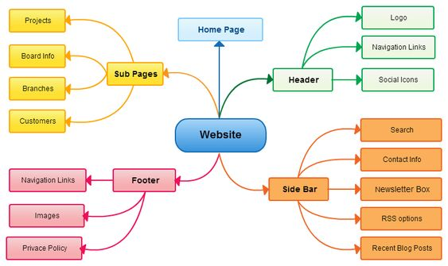
Example of Mind Map

Slide 15
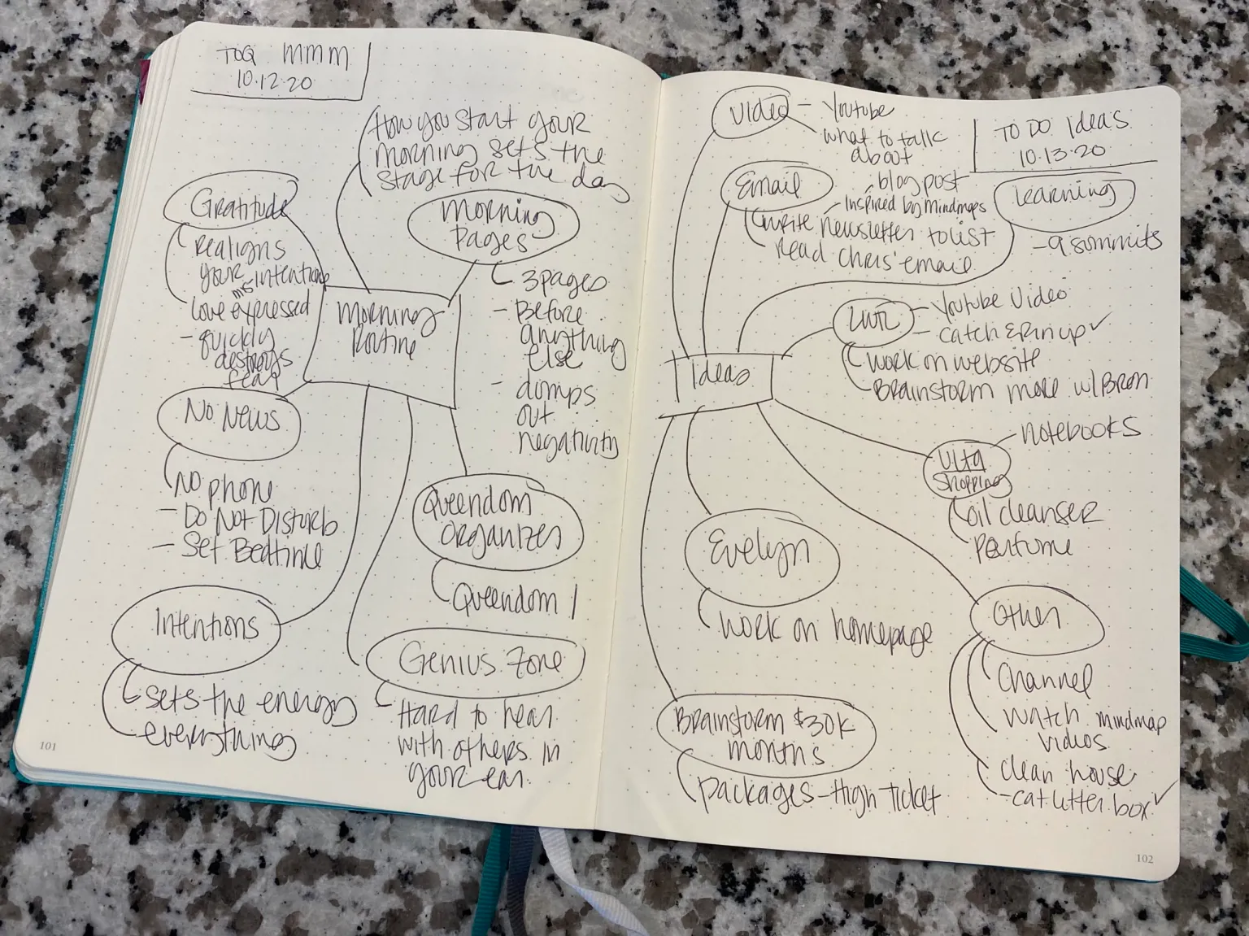
Example of Mind Map

Slide 16
Ways to Become More Creative
The Six Thinking Hats Method: The main idea is to have the group only “wear one hat at a time” when considering the problem.
There are 6 imaginary hats.
Each hat enables the problem solver to separate their thinking into 6 clear functions and roles.
By mentally wearing and switching “hats” you can easily focus or redirect thoughts, conflict, problem, or issue.

Slide 17
The 6 Thinking Hats
White hat: Recognizes that information is power, it is the gathering information and focuses on facts.
Blue hat: Manages the process. It involves listing the rules and how the problem will be solved in steps.
Green hat: Focuses on new ideas, creative concepts and, alternatives.
Yellow hat: Helps explore the feasibility and identify value and benefit.
Red hat: Signifies feelings and emotions. It could be the use of intuition and gut feelings.
Black hat: Is use of judgment or playing the “devil’s advocate”. Identifying what can go wrong and assessing potential problems.

Slide 18
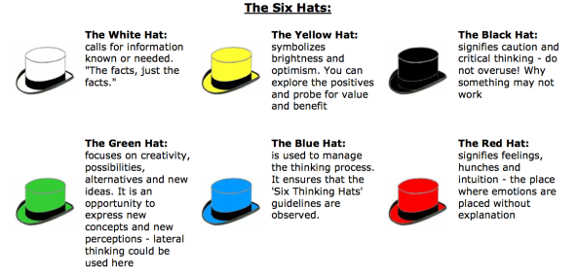
Question #1 – Use the “The Six Hats”
A customer has a warranty problem with a stove. The customer needs it repaired, but you can’t verify the warranty. The customer has lost the receipt. He is quite upset, and doesn’t want to have to pay for repairs.

Slide 19
Mind Map - Class Assignment
Using a problem (family, work, etc.) that you may be struggling with solving, create a mind map. The mind map may be handwritten or created using the computer.

Slide 20
Question #2
Your boss has put you in an unsafe position at work. He insists that you lock up at night when it is dark and take the money bag to the bank.
Identify the problem
List possible solutions
Decide on the best solution

Slide 21
Question #3
A co-worker sometimes makes comments about my body and it makes me uncomfortable. Although I've told her that I don't like her making comments like that, she hasn't stopped.
Identify the problem
List possible solutions
Decide on the best solution

Slide 22
Question #4
Your computer is always freezing. You have asked the computer tech guy to look at it and he says there is nothing wrong, but you continue to have problems.
Identify the problem
List possible solutions
Decide on the best solution

Slide 23
Reference
Soft Skills Personality Development for Life Success
By: Prashant Sharma

Slide 24
Dates to Remember
April 5: Assignments are due – See Modules Week 8
April 6: Project Day (Please make an effort to meet with your group.)
April 12: Submit Rough Draft of Paper and PowerPoint (Leader or appoint someone from your group)
April 19: Submit Final Draft of Paper and PowerPoint (Leader or appoint someone from your group
April 20: Presentation Day
April 26: Group Assessment (Questionnaire) – Individual Submissions
April 27: Last Regular Class Day
May 4: Final Exam (Career E-Portfolio)

